Slide 1
Implicit Bias: Understanding Automatic Thoughts and Feelings
Kate A. Ratliff, Ph.D.
Executive Director, Project Implicit
Assistant Professor, University of Florida

Slide 2
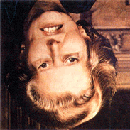
Thompson, 1980

Slide 3
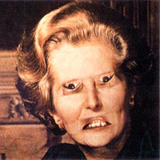
Thompson, 1980

Slide 4
Ba Ba?
Da Da or Tha Tha?
Ga Ga?
McGurk et al., 1996

Slide 5
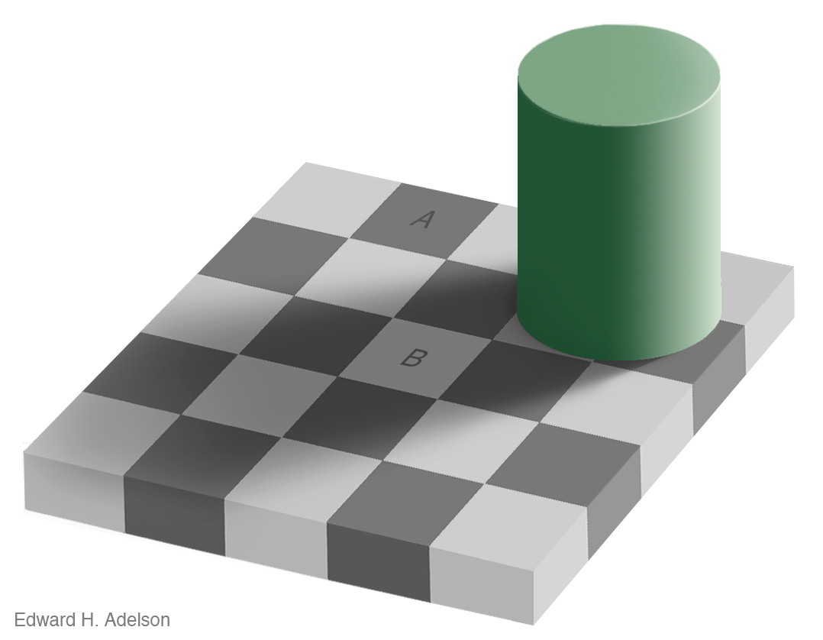
Adelson, 1995

Slide 6
Adelson, 1995

Slide 7
Adelson, 1995

Slide 8
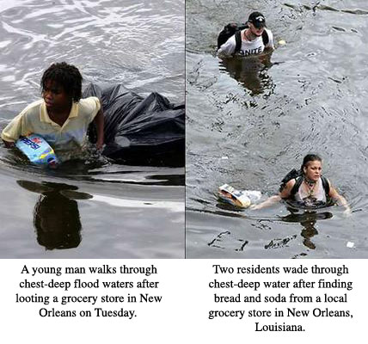
Looting
Finding

Slide 9
Bias:
Attitudes or stereotypes in favor or against a person or social group; a preference for one over another
Explicit Attitudes/
Stereotypes
Aware
Controllable
Introspection
Endorsed

Slide 10
Bias:
Attitudes or stereotypes in favor or against a person or social group; a preference for one over another
Explicit Attitudes/
Stereotypes
Implicit Attitudes/
Stereotypes
Aware
Less aware
Controllable
Less controllable
Introspection
Less introspection
Endorsed
No endorsement

Slide 11
Implicit Association Test

Slide 12
Implicit Association Test (IAT)
Block
Left
Right
1
Male
Female
2
Career
Family
3
Male or Career
Female or Family
4
Female
Male
5
Female or Career
Male or Family
Greenwald et al., 1998

Slide 13
Gender-Stereotyping IAT: Overall Results
(N = 846,020 Project Implicit Participants)
Male-Family/
Female-Career (8%)
Female-Family/
Male-Career (75%)
Notes:
13

Slide 14
Race IAT: Overall Results
(N = 1,697,560 White Project Implicit Participants)
African American-Good/
White American-Bad (11%)
White American-Good/
African American-Bad (74%)
Notes:
14

Slide 15
Three Simple Ideas
(that are difficult to believe)
Much of mental life occurs (relatively) outside of awareness
Biases that occur outside of awareness (implicit bias) can contradict our stated beliefs (explicit bias)
Behavior is shaped by both implicit and explicit bias

Slide 16
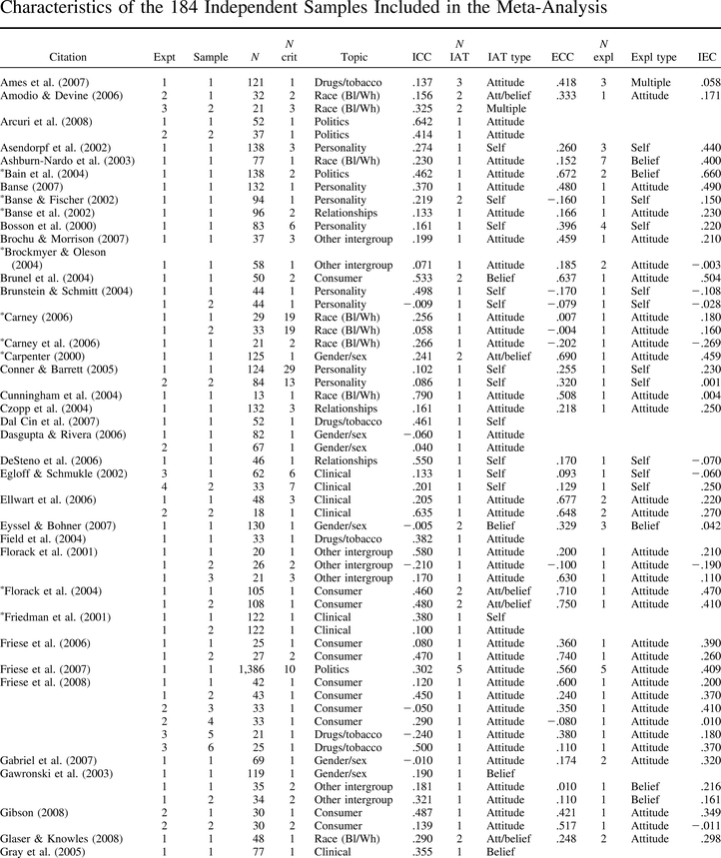
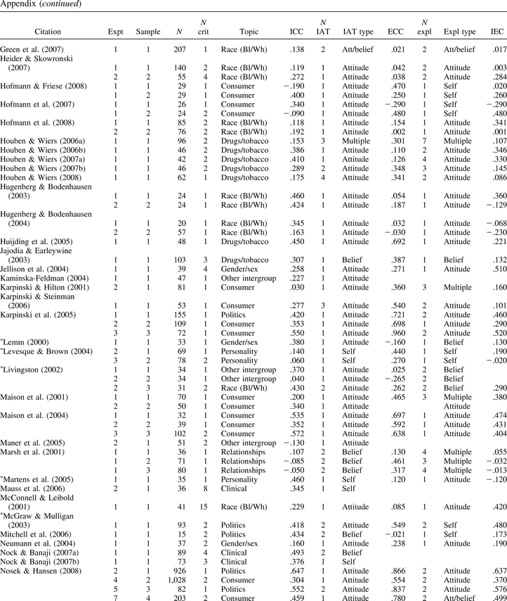
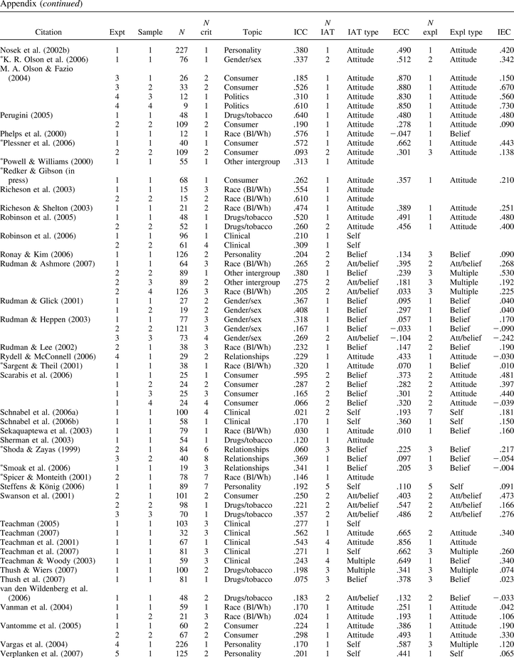
Implicit Attitudes and Behavior
Meta-analyses show that IAT scores predict a wide variety of real-world behaviors (N = 184 studies)
Greenwald et al., 2009; Oswald et al., 2013; Carlsson & Agerstrom, 2016

Slide 17
Implicit Attitudes and Health Care
Excerpt: Mr. Thompson is a 50-year-old (black/white) man with a history of well-known controlled hypertension and smoking... he appears to be in a lot of pain describing it as “sharp, like being stabbed with a knife”... EKG shows 2 mm horizontal ST elevations in the anterior leads (not J-point elevation)... no absolute contraindications to thrombolysis.
Green et al., 2007
Notes:
17

Slide 18
Implicit Attitudes and Health Care
Black Patient
Yes
White Patient
Treatment with Thrombolysis
No
Low
High
Degree of Implicit Bias
Green et al., 2007
Notes:
18

Slide 19
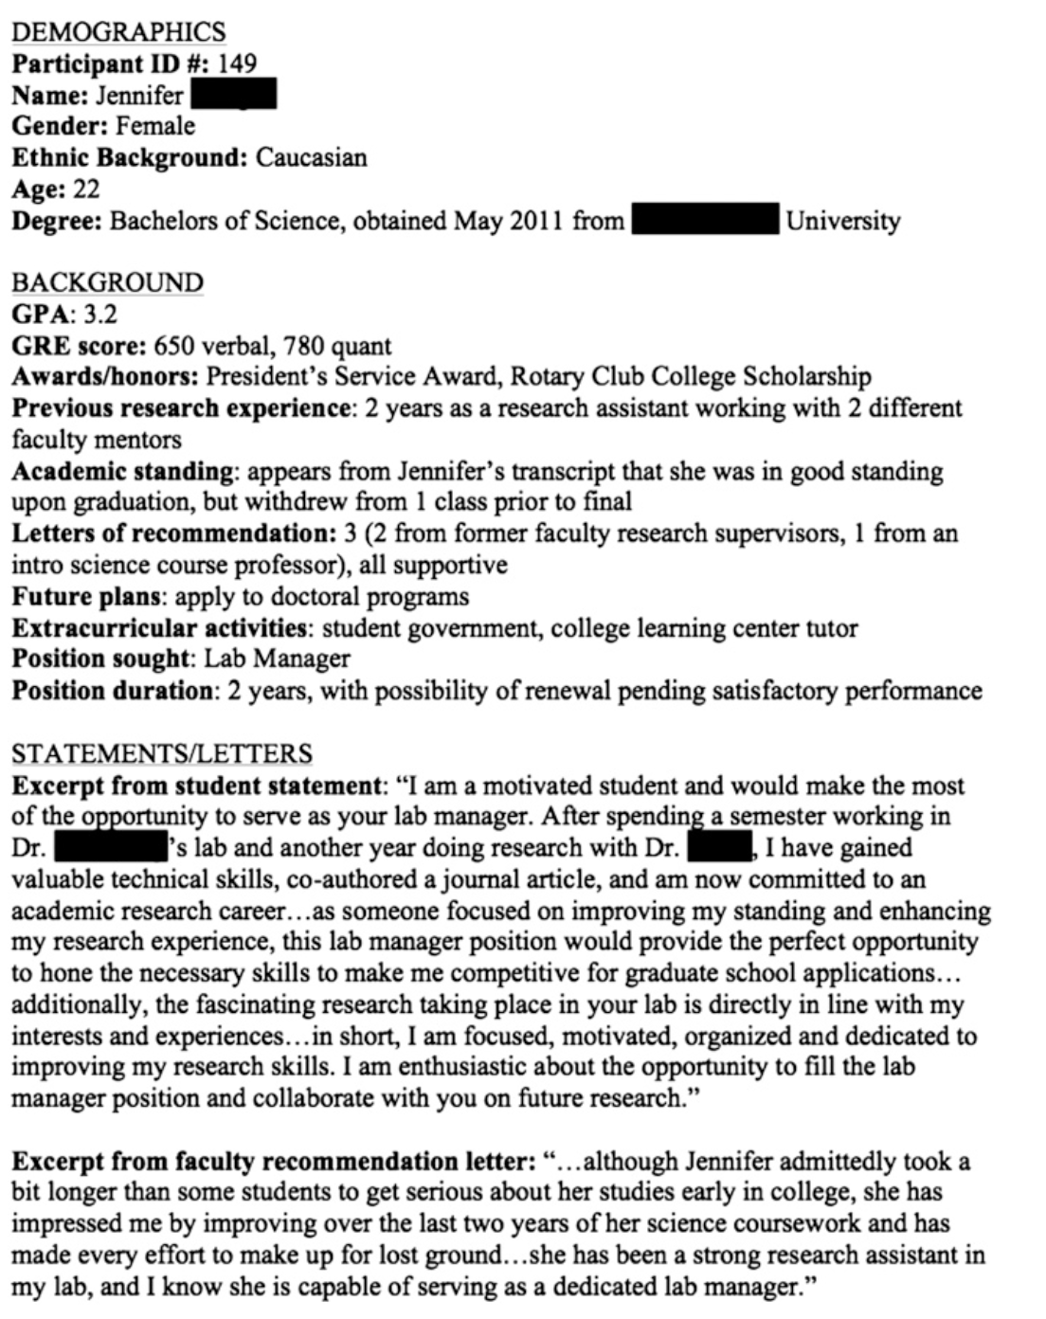
John, Jennifer
Moss-Racusin et al., 2012

Slide 20
Implicit Attitudes and STEM Hiring
$30,238
31k
30K
Black applicants
(e.g., Bertrand & Mullainathan, 2004)
Obese applicants
(e.g., Giel et al., 2012)
Muslim applicants
(e.g., Agerstrom & Rooth, 2009)
29K
28K
$26,507
27K
26K
25K
Male Applicant
Female Applicant
Mediated by differences in perceived competence
Moss-Racusin et al., 2012

Slide 21
Bias Mitigation
Strategies for reducing personal implicit bias
Strategies focused on reducing the opportunity for unwanted bias to influence decision-making

Slide 22
Mitigating the Impact of Unwanted Bias
Bias is influential when...

Slide 23
Mitigating the Impact of Unwanted Bias
Bias is influential when...
Information is ambiguous and complex (e.g., Bodenhausen et al., 2016)
Decision-making criteria are unclear (e.g., Uhlmann & Cohen, 2005)

Slide 24
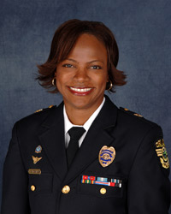
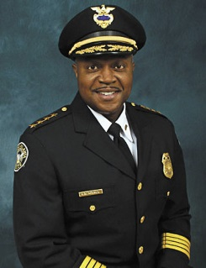
Constructed Criteria
Streetsmart
Educated
Tough
Patrol experience
Respect from officers
Risk taker
Good physical shape
Formally educated
Administrative skills
Supervisory experience
Politically connected
Media training
Uhlmann & Cohen, 2005

Slide 25
Mitigating the Impact of Unwanted Bias
Bias is influential when...
Information is ambiguous and complex (e.g., Bodenhausen et al., 2016)
Decision-making criteria are unclear (e.g., Uhlmann & Cohen, 2005)
To mitigate the effects of bias we could...
Develop and prioritize evaluation criteria in advance and judge all candidates in comparison to those criteria

Slide 26
Mitigating the Impact of Unwanted Bias
Bias is influential when...
Decisions must be made quickly (e.g., Fazio & Olson, 2014)
One is tired, stressed, or otherwise depleted (e.g., Friese et al., 2008)
To mitigate the effects of bias we could...
Slow down; calm down; plan to evaluate during your best time of day

Slide 27
Mitigating the Impact of Unwanted Bias
Bias is influential when...
Organizational climate permits it (e.g., Ziegert & Hanges, 2005)

Slide 28
Mitigating the Impact of Unwanted Bias
Bias is influential when...
Organizational climate permits it (e.g., Ziegert & Hanges, 2005)
To mitigate the effects of bias we could...
Make anti-bias an explicit priority; lead from the top

Slide 29
Mitigating the Impact of Unwanted Bias
Bias is influential when...
Organizational climate permits it (e.g., Ziegert & Hanges, 2005)
To mitigate the effects of bias we could...
Make anti-bias an explicit priority; lead from the top
Consider patterns of selective benevolence

Slide 30
Mitigating the Impact of Unwanted Bias
Bias is influential when...
Organizational climate permits it (e.g., Ziegert & Hanges, 2005)
To mitigate the effects of bias we could...
Make anti-bias an explicit priority; lead from the top
Consider patterns of selective benevolence
Think hard about using “fitting in” as a criterion

Slide 31
Mitigating the Impact of Unwanted Bias
Bias is influential when...
We are overconfident in our objectivity (e.g., Uhlmann & Cohen, 2007)

Slide 32
Mitigating the Impact of Unwanted Bias
Bias is influential when...
We are overconfident in our objectivity (e.g., Uhlmann & Cohen, 2007)
To mitigate the effects of bias we could...
Honestly consider your practices; be humble

Slide 33
Mitigating the Impact of Unwanted Bias
Bias is influential when...
We are overconfident in our objectivity (e.g., Uhlmann & Cohen, 2007)
To mitigate the effects of bias we could...
Honestly consider your practices; be humble
Actively search for counterevidence for decisions

Slide 34
Mitigating the Impact of Unwanted Bias
Bias is influential when...
We are overconfident in our objectivity (e.g., Uhlmann & Cohen, 2007)
To mitigate the effects of bias we could...
Honestly consider your practices; be humble
Actively search for counterevidence for decisions
Create practices with the idea that you are biased

Slide 35
Mitigating the Impact of Unwanted Bias
Bias is influential when...
We are overconfident in our objectivity (e.g., Uhlmann & Cohen, 2007)
To mitigate the effects of bias we could...
Honestly consider your practices; be humble
Actively search for counterevidence for decisions
Create practices with the idea that you are biased
Be transparent

Slide 36
Three Simple Ideas
(that are difficult to believe)
Much of mental life occurs (relatively) outside of awareness
Biases that occur outside of awareness (implicit bias) can contradict our stated beliefs (explicit bias)
Behavior is shaped by both implicit and explicit bias

Slide 37
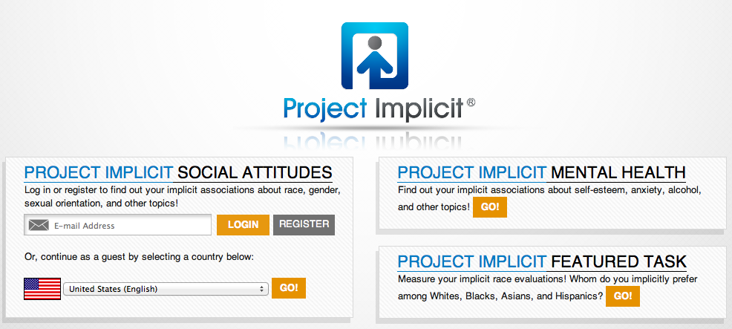
Project Implicit http://projectimplicit.net
PI Research Site https://implicit.harvard.edu
My Academic Site http://kateratliff.com

